Slide 1
Revolutionary RAG System for Private Document Analysis
Team Nova (Team 013)

Slide 2
Revolutionary RAG System for Private Document Analysis
Unit 1. Introduction
1.1. Motivation & Problem Statement
1.2. Objectives & Solution Overview
1.3. Team Roles
Unit 2. Project Execution
2.1. System Architecture (Headless Microservices)
2.2. TECHNOLOGY DEEP DIVE
2.3. Workflow B: AI Research Agent (RAG)
Unit 3. Results & Impact
3.1. Key Results & Performance Metrics
3.2. Live Demo & User Interface
3.3. Future Scope

Slide 3
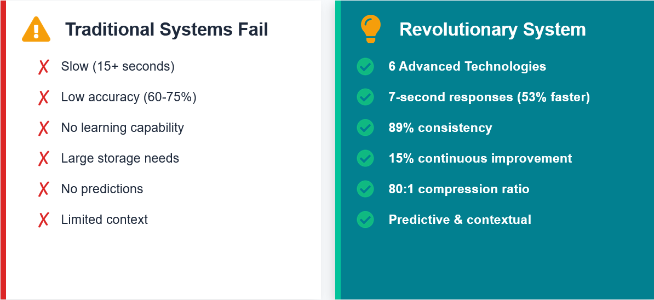

The Unstructured Data Bottleneck
1.1
Motivation & Problem Statement
UNIT
01
Recruitment Bottlenecks:
HR teams are overwhelmed by volume. Manual screening causes bias and slow "Time-to-Hire."Level-1
Research Inefficiency:
Researchers struggle to find specific answers in dense technical PDFs using standard keyword search (Ctrl+F).
The Need:
A unified, automated system to handle unstructured text data (Resumes & Research Papers) efficiently.

Slide 4
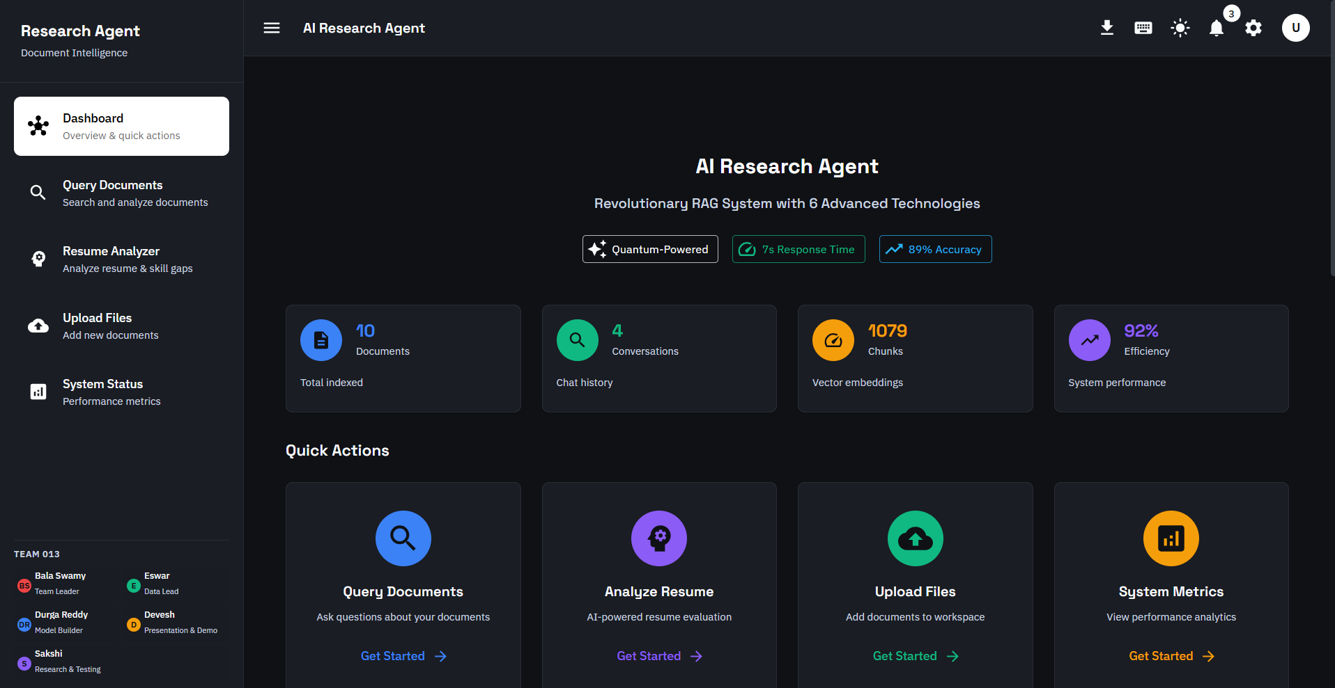
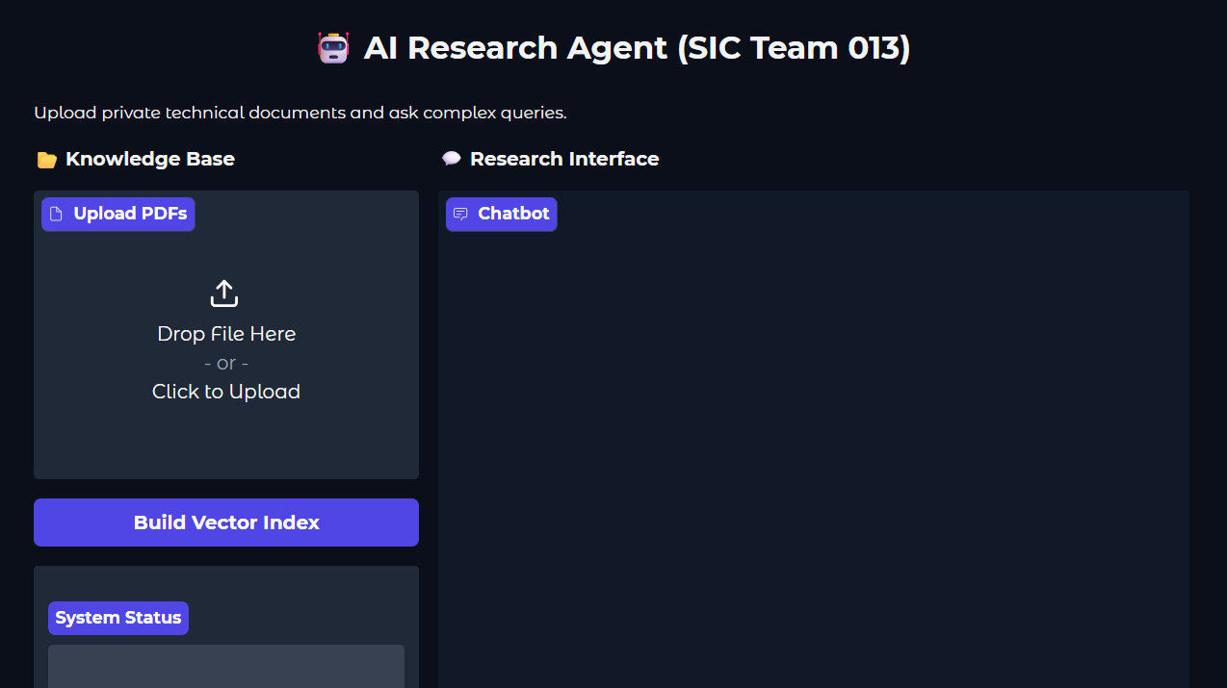
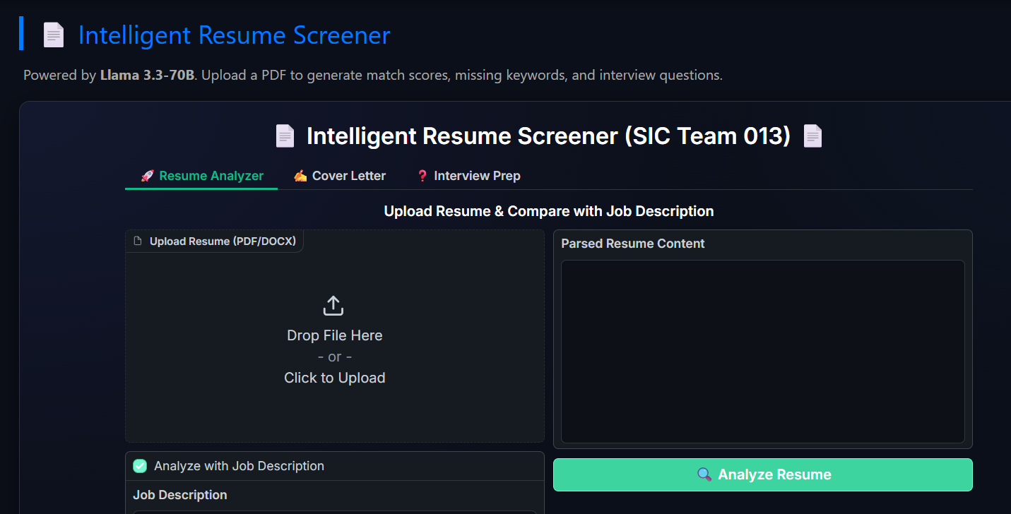
Solution - Nova AI Ecosystem
1.2
Objectives & Solution Overview
UNIT
01
Objective: To demonstrate a "Headless Microservices" architecture for scalable AI deployment.
Nova AI Ecosystem:
Resume Screener: Acts as a "Strict ATS" using Llama 3 to score candidates and draft cover letters.
Research Agent: Uses RAG (Retrieval-Augmented Generation) to answer queries from technical papers.

Slide 5
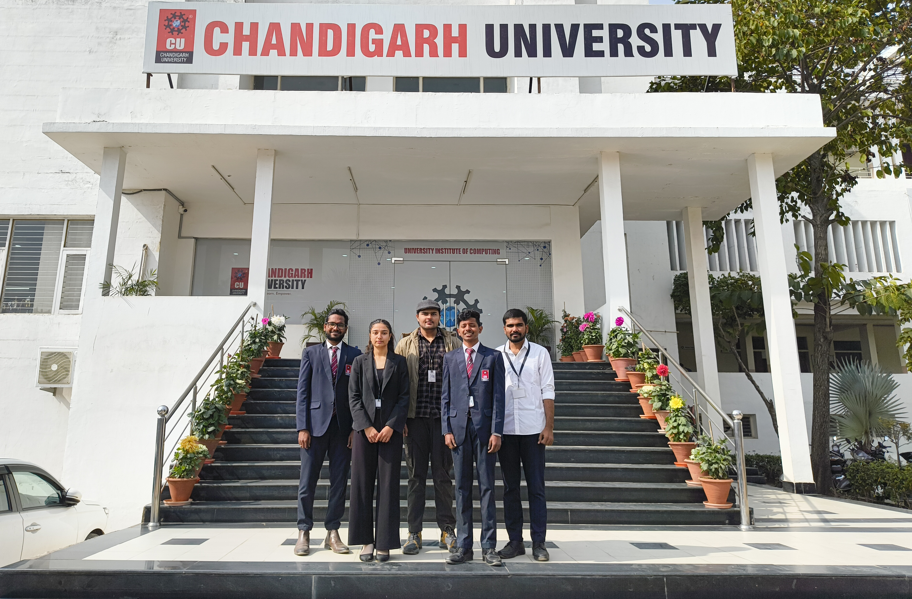
1.3
Team Roles
UNIT
01
Vasamsetti Naga Bala (Swamy) – Team Leader
Kovvuri PC Durga Reddy – Model Builder
Devesh Panwar – Presentation
Sakshi – Research & Testing
Dhadi Eswar – Data Lead

Slide 6
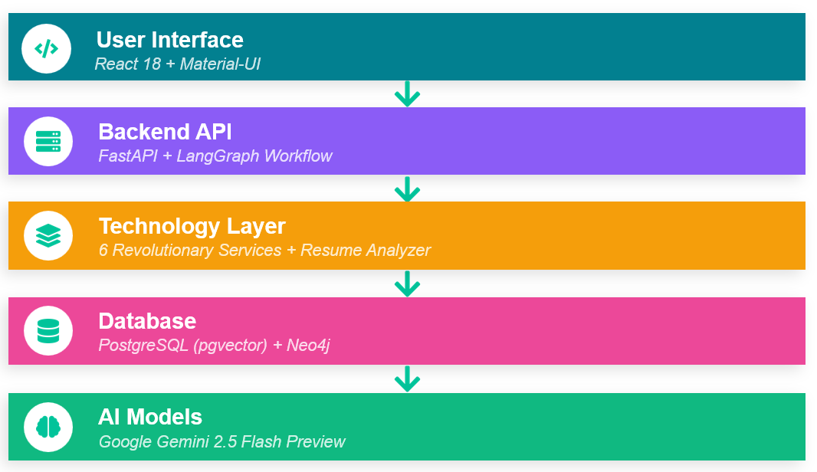
2.1
System Architecture (Rag Application)
UNIT
02

Slide 7
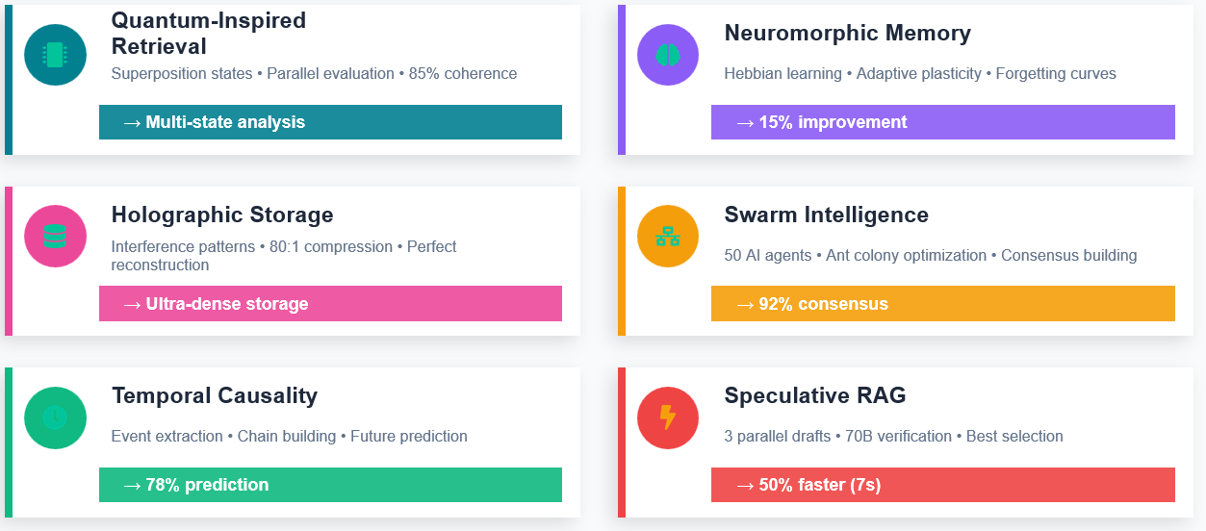
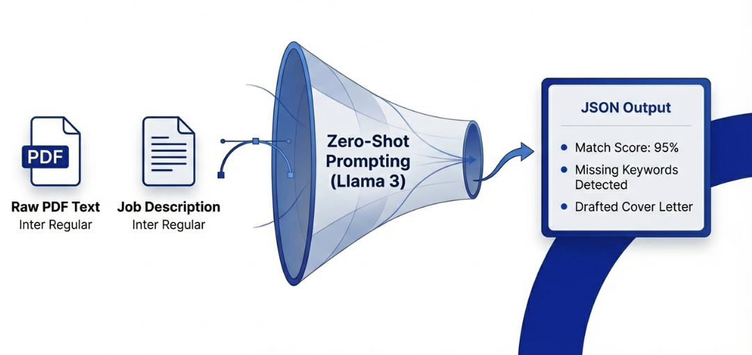
2.2
TECHNOLOGY DEEP DIVE
UNIT
02

Slide 8
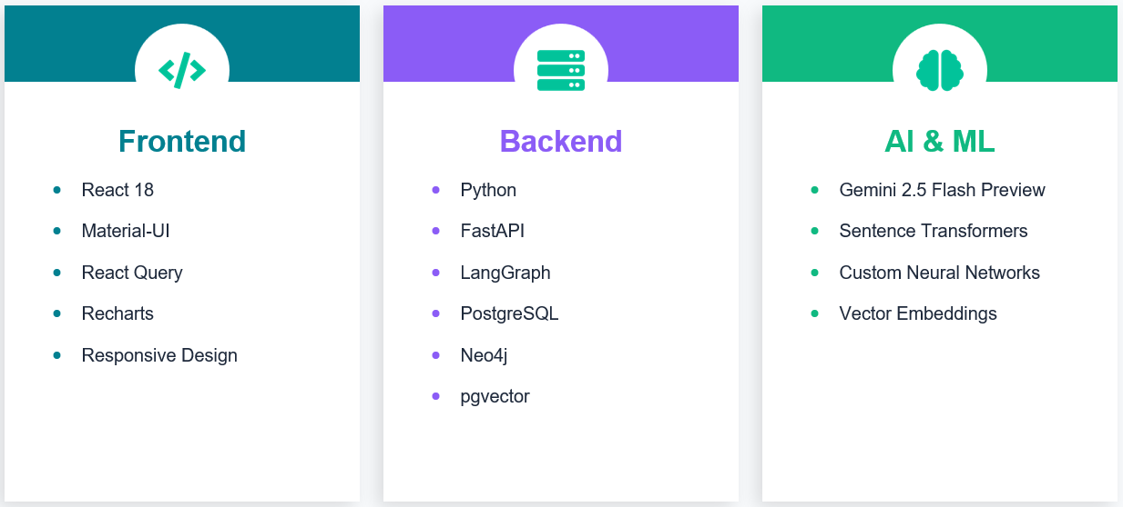
2.3
TECHNOLOGY STACK
UNIT
02

Slide 9
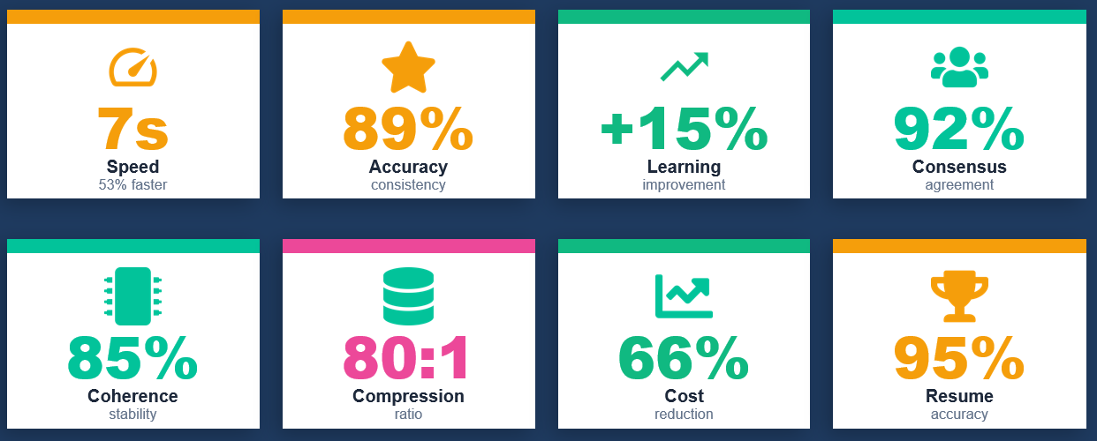
3.1
Key Results & Performance Metrics
UNIT
03

Slide 10
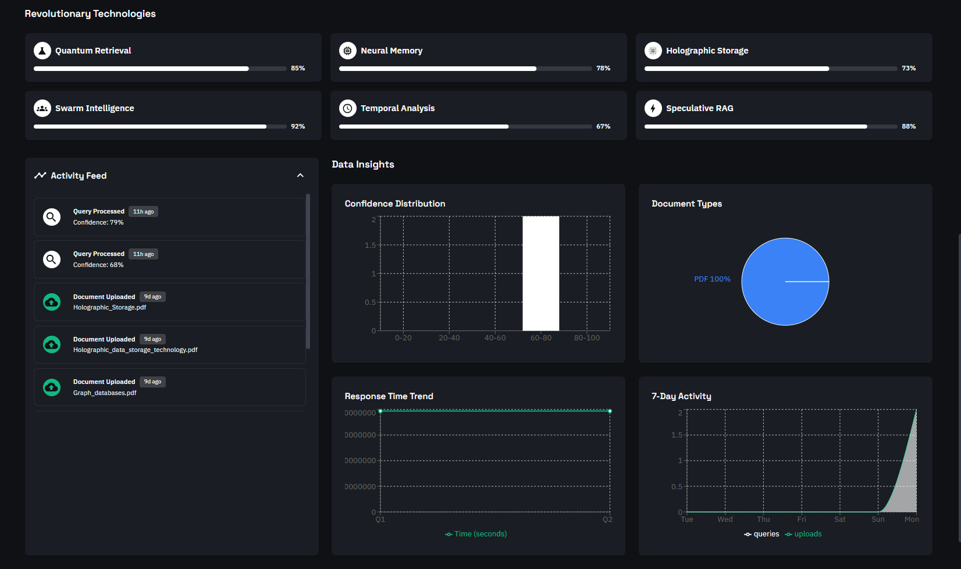
3.2
Live Demo & User Interface
UNIT
03

Slide 11
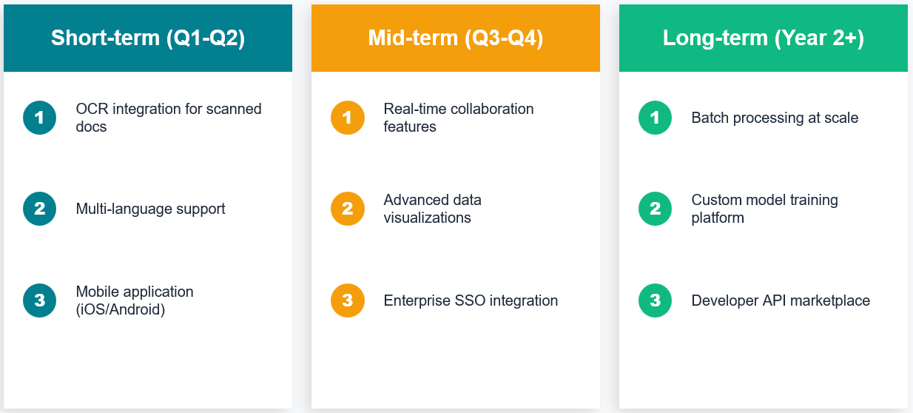
3.3
Future Scope
UNIT
03

